Slide 1
Introduction to DEEP LEARNING
Learning Neural networks
Alvaro H. C. Correia
Department of Mathematics and Computer Science

Slide 2
INTRODUCTION

Slide 3
Deep Learning
A sub-field of machine learning.
Learning of multiple levels of representation.
Well suited for complex problems with lots of structure:
Computer Vision;
Natural Language Processing (NLP).
Data hungry.

Slide 4
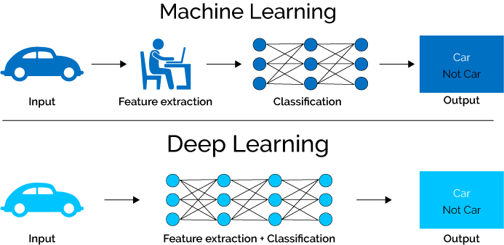
Deep Learning vs Machine Learning
Eliminates the need for manual feature extraction;
Relevant features are learned during training.

Slide 5
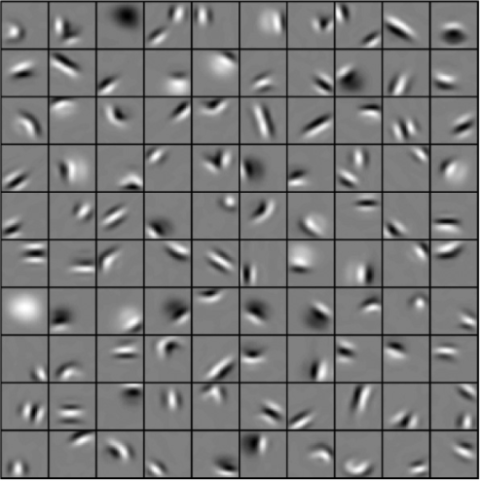
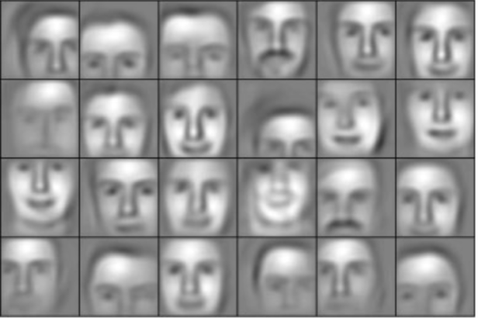
Representation Learning
How to best represent the data to complete a certain task
Low-level features
Mid-level features
High-level features
Lee, Honglak, et al. “Unsupervised learning of hierarchical representations with convolutional deep belief networks.” Communications of the ACM 54.10 (2011): 95-103.

Slide 6
Deep Impulse
Why has deep learning got such traction?
Data
Hardware
Software

Slide 7
PERCEPTRON

Slide 8
Perceptron
Approximate some function $\hat{y}=f(x)$
$$\hat{y}=f^{∗}\left(x;W\right)=g\left(\sum_{i=1}^{n}{w_{i}x_{i}}\right)$$
$$g\left(z\right)= \left\{\begin{aligned}1 if z>0 \\ 0 if z≤0\end{aligned}\right.$$
$${ x}_{1}$$
$$w_{1}$$
$${ x}_{2}$$
$$w_{2}$$
$$Σ$$
$$g$$
$$\hat{y}$$
$$⋮$$
$$w_{n}$$
$${ x}_{n}$$
Input
Weights
Sum
Activation
Output
Rosenblatt, Frank. "The perceptron: a probabilistic model for information storage and organization in the brain." Psychological review 65.6 (1958): 386.

Slide 9
Perceptron
Approximate some function $\hat{y}=f(x)$
$$\hat{y}=f^{∗}\left(x;W\right)=g\left(w_{0}+\sum_{i=1}^{n}{w_{i}x_{i}}\right)$$
Vectorised form
$$\hat{y}=g\left(Wx\right)$$
$$W=\left[\begin{matrix}w_{0} & w_{1} & ⋯ & w_{n}\end{matrix}\right] x= \left[\begin{matrix}1 \\ x_{1} \\ \begin{aligned}\begin{aligned}x_{2} \\ ⋮\end{aligned} \\ x_{n}\end{aligned}\end{matrix}\right]$$
$$1$$
$$w_{0}$$
$${ x}_{1}$$
$$w_{1}$$
$${ x}_{2}$$
$$w_{2}$$
$$Σ$$
$$g$$
$$\hat{y}$$
$$⋮$$
$$w_{n}$$
$${ x}_{n}$$
Input
Weights
Sum
Activation
Output

Slide 10
Multi-Output Perceptron
Approximate some function $\hat{y}=f(x)$
$$\hat{y}=f^{∗}\left(x;W\right)=g\left(w_{0}+\sum_{i=1}^{n}{w_{i}x_{i}}\right)$$
Vectorised form
$$\hat{y}=g\left(Wx\right)$$
$$W=\left[\begin{matrix}w_{1,0} & w_{1,1} & ⋯ & w_{1,n} \\ w_{2,0} & w_{2,1} & ⋯ & w_{2,n}\end{matrix}\right] x= \left[\begin{aligned}1 \\ x_{1} \\ x_{2} \\ ⋮ \\ x_{n}\end{aligned}\right]$$
$$1$$
$$w_{1,0}$$
$${ x}_{1}$$
$$w_{1,1}$$
$$w_{1,2}$$
$$w_{2,0}$$
$$Σ$$
$${\hat{y}}_{1}$$
$${ x}_{2}$$
$$w_{2,1}$$
$$g$$
$$⋮$$
$$w_{2,2}$$
$$Σ$$
$$w_{1,n}$$
$${\hat{y}}_{2}$$
$${ x}_{n}$$
$$w_{2,n}$$
Input
Weights
Sum
Activation
Output

Slide 11
Multi-layer Perceptron
Approximate some function$\hat{y}=f(x)$
$$\hat{y}=f^{∗}\left(x;W \right)=f^{1}\left(f^{2}\left(⋯f^{L}\left(x\right)\right)\right)$$
Each $f^{k}$ is a layer of neurons
$$\hat{y}=g(W^{2}g\left(W^{1}x\right))$$
$$W^{1}=\left[\begin{matrix}w_{1,0}^{1} & w_{1,1}^{1} & ⋯ & w_{1,n}^{1} \\ w_{2,0}^{1} & w_{2,1}^{1} & ⋯ & w_{2,n}^{1}\end{matrix}\right] x= \left[\begin{aligned}1 \\ x_{1} \\ x_{2} \\ ⋮ \\ x_{n}\end{aligned}\right]$$
$$W^{2}=\left[\begin{matrix}w_{1}^{2} & w_{2}^{2}\end{matrix}\right]$$
$$1$$
$$w_{1,0}$$
Hidden layer
$${ x}_{1}$$
$$w_{1,1}$$
$$w_{1,2}$$
$$w_{2,0}$$
$$Σ$$
$$h_{1}$$
$$w_{1}^{2}$$
$${ x}_{2}$$
$$w_{2,1}$$
$$g$$
$$Σ$$
$$g$$
$$\hat{y}$$
$$w_{2,2}$$
$$w_{2}^{2}$$
$$⋮$$
$$w_{1,n}$$
$$Σ$$
$$h_{2}$$
$${ x}_{n}$$
$$w_{2,n}$$
Input
Weights
Sum
Activation
Output

Slide 12
Multi-layer Perceptron
Approximate some function $\hat{y}=f(x)$
$$\hat{y}=f^{∗}\left(x;W \right)=f^{1}\left(f^{2}\left(⋯f^{n}\left(x\right)\right)\right)$$
Each $f^{n}$ is a layer of neurons
$$\hat{y}=g(W^{2}g\left(W^{1}x\right))$$
$$W^{1}=\left[\begin{matrix}w_{1,0}^{1} & w_{1,1}^{1} & ⋯ & w_{1,n}^{1} \\ w_{2,0}^{1} & w_{2,1}^{1} & ⋯ & w_{2,n}^{1}\end{matrix}\right] x= \left[\begin{aligned}1 \\ x_{1} \\ x_{2} \\ ⋮ \\ x_{n}\end{aligned}\right]$$
$$W^{2}=\left[\begin{matrix}w_{1}^{2} & w_{2}^{2}\end{matrix}\right]$$
$$1$$
$$w_{0,1}$$
$${ x}_{1}$$
$$w_{1,1}$$
$$w_{2,1}$$
$$w_{0,2}$$
$$h_{1}$$
$$w_{1}^{2}$$
$${ x}_{2}$$
$$w_{1,2}$$
$$\hat{y}$$
$$w_{2,2}$$
$$w_{2}^{2}$$
$$⋮$$
$$w_{n,1}$$
$$h_{2}$$
$${ x}_{n}$$
$$w_{n,2}$$
Input layer
Hidden layer
Output layer

Slide 13
Multi-layer Perceptron
Approximate some function $\hat{y}=f(x)$
$$\hat{y}=f^{∗}\left(x;W \right)=f^{1}\left(f^{2}\left(⋯f^{n}\left(x\right)\right)\right)$$
Each $f^{n}$ is a layer of neurons
$$\hat{y}=g(W^{2}g\left(W^{1}x\right))$$
$$W^{1}=\left[\begin{matrix}w_{1,0}^{1} & w_{1,1}^{1} & ⋯ & w_{1,n}^{1} \\ w_{2,0}^{1} & w_{2,1}^{1} & ⋯ & w_{2,n}^{1}\end{matrix}\right] x= \left[\begin{aligned}1 \\ x_{1} \\ x_{2} \\ ⋮ \\ x_{n}\end{aligned}\right]$$
$$W^{2}=\left[\begin{matrix}w_{1}^{2} & w_{2}^{2}\end{matrix}\right]$$
$$1$$
$${ x}_{1}$$
$$h_{1}$$
$${ x}_{2}$$
$$\hat{y}$$
$$⋮$$
$$h_{2}$$
$${ x}_{n}$$
Dense or fully connected layers

Slide 14
NEURAL NETWORKS

Slide 15
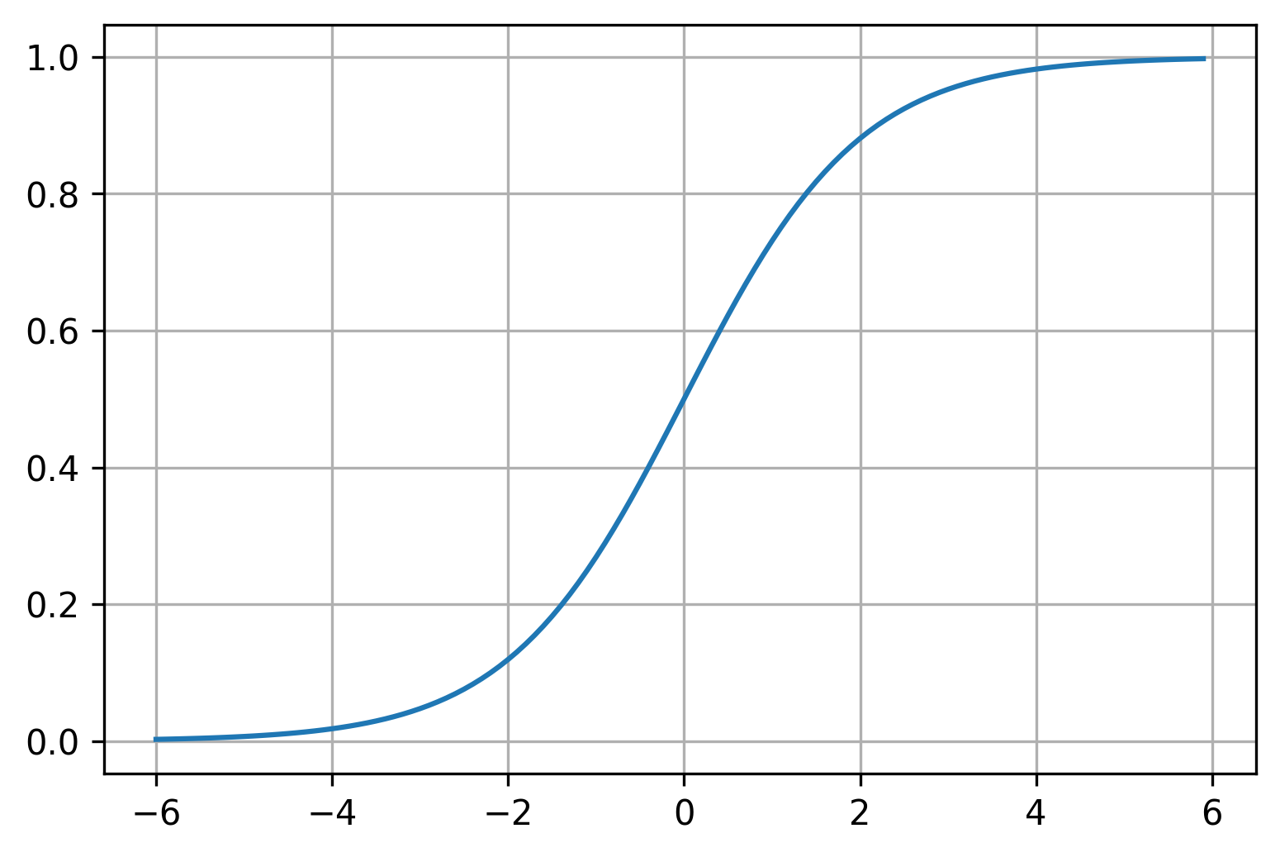
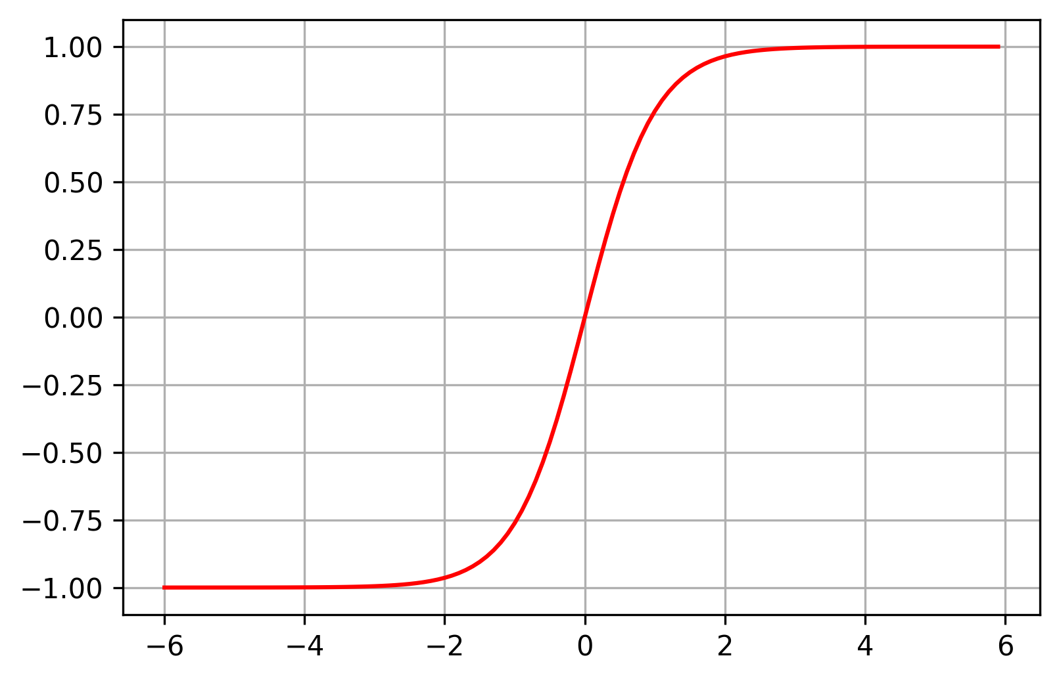
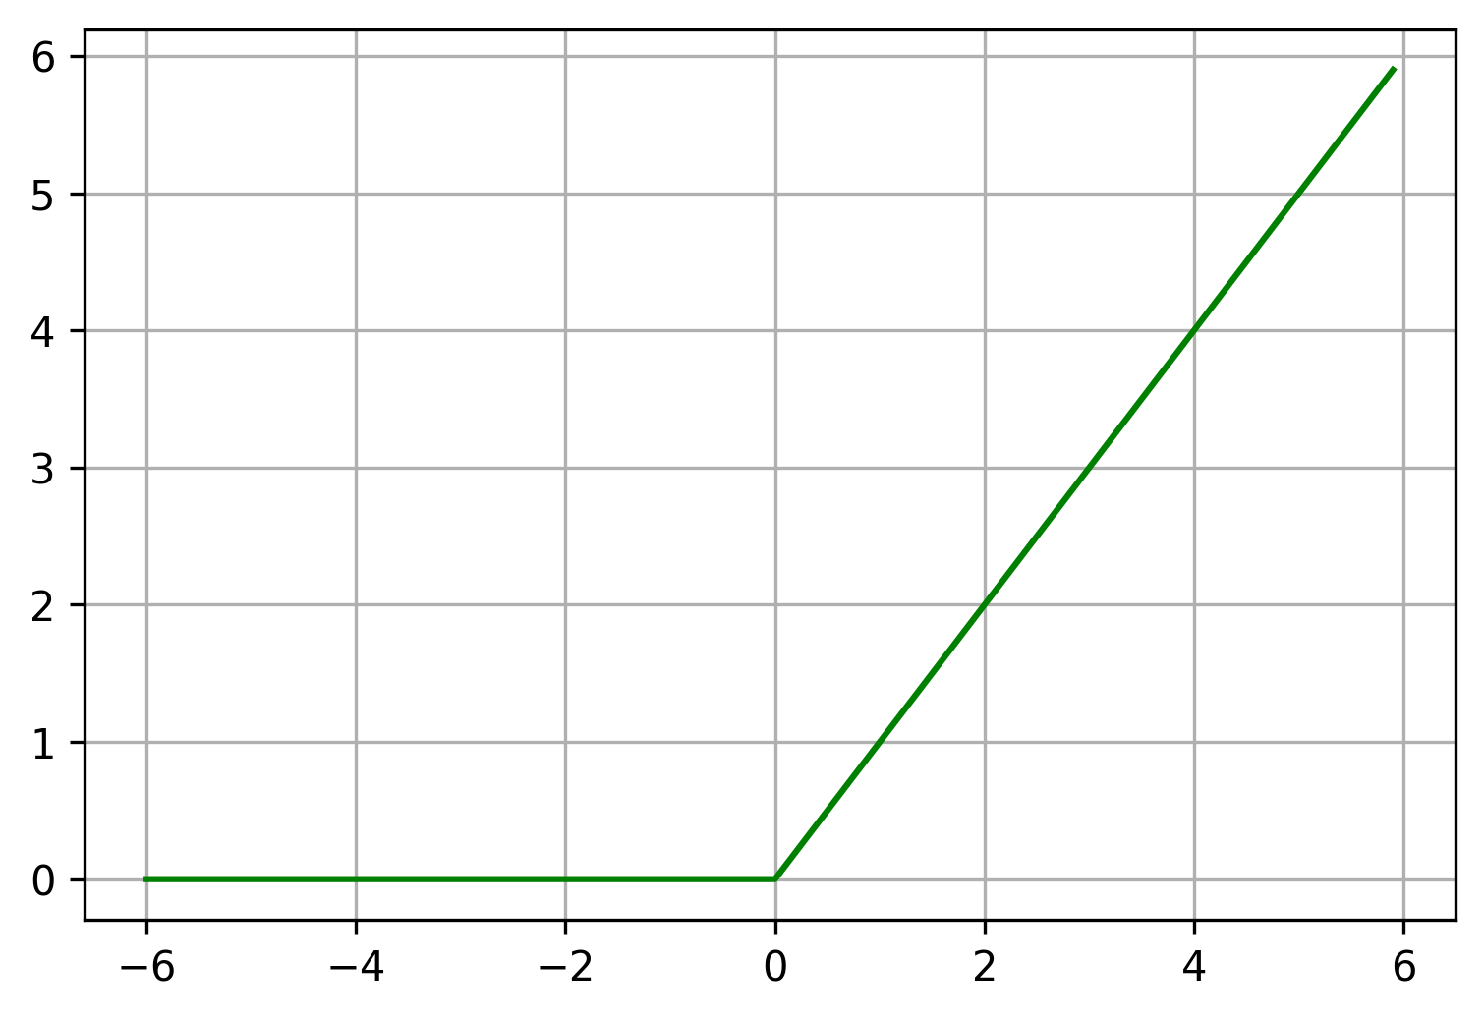
Non-linearity Types of Activation Function
Logistic Function
Hyperbolic Tangent
Rectified Linear Unit (ReLU)
$$σ\left(x\right)=\frac{1}{1+e^{−x}}=\frac{e^{x}}{e^{x}+1}$$
tanh$\left(x\right)=\frac{e^{x} −{ e}^{−x}}{e^{x} +{ e}^{−x}}$
R$eLu\left(x\right)=\max\left(0, x\right)$
LeCun, Yann A., et al. "Efficient backprop." Neural networks: Tricks of the trade. Springer, Berlin, Heidelberg, 2012. 9-48.
Notes:
Sigmoid: Squashing function to approximate probabilities; Always positive, no negative gradients; non-zero mean.
Tanh: Zero-mean, better convergence; Vanishing gradients.
ReLU: Helps with vanishing gradients; Increase sparsity.

Slide 16
Linear Maps
Rotate
Shear
Shear and Rotate
$$W_{r}=\left[\begin{matrix}cos⁡(30°) & −sin⁡(30°) \\ sin⁡(30°) & cos⁡(30°)\end{matrix}\right]$$
$$W_{s}=\left[\begin{matrix}1 & 2 \\ 0 & 1\end{matrix}\right]$$
$${W_{s}W}_{r}$$
https://notgnoshi.github.io/linear-transformations/
Notes:
Linear Maps:
Keep gridlines parallel
Keep gridlines evenly spaced
Keep origin stationary

Slide 17
Hyperbolic tangent of shear operation
$$W_{s}=\left[\begin{matrix}1 & 2 \\ 0 & 1\end{matrix}\right]$$
$${tanh(W}_{s}x)$$

Slide 18
Hyperbolic tangent of rotation operation
$$W_{r}=\left[\begin{matrix}cos⁡(30°) & sin⁡(30°) \\ −sin⁡(30°) & cos⁡(30°)\end{matrix}\right]$$
$${tanh(W}_{r}x)$$

Slide 19
Non-Linear Maps
Rotate
Shear
Shear and Rotate
$$tanh(W_{r}x)$$
$$W_{r}=\left[\begin{matrix}cos⁡(30°) & −sin⁡(30°) \\ sin⁡(30°) & cos⁡(30°)\end{matrix}\right]$$
$$tanh(W_{s}x)$$
$$W_{s}=\left[\begin{matrix}1 & 2 \\ 0 & 1\end{matrix}\right]$$
$${{tanh(W}_{s}tanh(W}_{r}x))$$

Slide 20
Non-Linear Maps
Sequence of non-linear operations Complex behaviour

Slide 21
Classification example
Separate the red data points from the blue ones
https://scikit-learn.org/stable/auto_examples/classification/plot_classifier_comparison.html

Slide 22
Classification example
Without an activation, we can only define a linear decision boundary
https://scikit-learn.org/stable/auto_examples/classification/plot_classifier_comparison.html

Slide 23
Classification example
With a non-linear activation, we can define complex decision boundaries
https://scikit-learn.org/stable/auto_examples/classification/plot_classifier_comparison.html

Slide 24
Single-layer neural network
$$1$$
$$h_{1}$$
$$\hat{y_{1}}$$
$${ x}_{1}$$
$$h_{2}$$
$$\hat{y_{2}}$$
$${ x}_{2}$$
$$⋮$$
$$⋮$$
$$⋮$$
$$\hat{y_{n_{y}}}$$
$$h_{n_{h}}$$
$${ x}_{n_{x}}$$
$n_{x}$input size
$n_{h}$ hidden layer size
$n_{y}$ output size

Slide 25
Deep neural network
$$1$$
$$h_{1}$$
$$h_{1}$$
$$h_{1}$$
$$\hat{y_{1}}$$
$${ x}_{1}$$
$$h_{2}$$
$$h_{2}$$
$$h_{2}$$
$$\hat{y_{2}}$$
$${ x}_{2}$$
$$…$$
$$⋮$$
$$⋮$$
$$⋮$$
$$⋮$$
$$⋮$$
$$h_{n_{h_{1}}}$$
$$h_{n_{h_{2}}}$$
$$h_{n_{h_{3}}}$$
$$\hat{y_{n_{y}}}$$
$${ x}_{n}$$
$n$ input size
$n_{h_{1}}$ first hidden layer size
$$⋮$$
$n_{y}$ output size

Slide 26
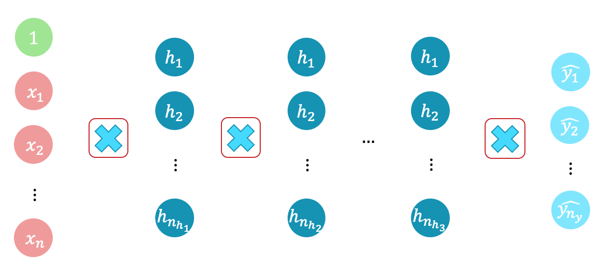
Inference - Forward Pass Matrix multiplication
$$\hat{y}=f^{∗}\left(x;W \right)=f^{1}\left(f^{2}\left(⋯f^{L}\left(x\right)\right)\right) \\ \hat{y}=g\left(W^{L}⋯g\left(W^{2}g\left(W^{1}x\right)\right)\right)$$

Slide 27
Learning- Backward Pass or Backprop Matrix multiplication
$$W←W−ΔW$$
Learning update
Iteratively update the network parameters (weights)

Slide 28
Notation
Dataset $X^{n_{x}×m}, y^{n_{y}×m}$ $m$ pairs $(x, y)\left\{\begin{aligned}\text{Each} x \text{is} \text{a} \text{vector} \text{of} \text{size} n_{x}\text{: }x=\left(x_{1}, x_{2},⋯,x_{n_{x}}\right) \\ \text{Each} y \text{is} \text{a} \text{vector} \text{of} \text{size} n_{y}\text{: }y=(y_{1}, y_{2},⋯,y_{n_{y}})\end{aligned}\right.$
$x_{i,j}$ is the $j^{th}$ variable of the $i^{th}$ instance
Network $L$ (hidden) layers
Each layer $l$ is composed of $n_{h_{l}}$neurons
Each layer has a corresponding set of weights $W_{l}^{n_{h_{l+1}}×n_{h_{l}}}$
(number of neurons of next layer $×$ number of neurons of current layer)

Slide 29
LEARNING

Slide 30
Loss function
Quantify how the output $\hat{y}=f^{∗}\left(x;W\right)$ differs from the ‘true’ one $y$.
$$ℒ(f^{∗}\left(x;W\right), y)$$
Regression: predicting a real number Square error $ℒ\left(\hat{y}, y\right)={\left(\hat{y} −y\right)}^{2}$
Classification: predicting a class Log-loss $ℒ\left(\hat{y}, y\right)=−\sum_{j}{\log\left({\hat{y}}_{j}\right)y_{j}}$

Slide 31
Loss function Empirical loss or Cost function
The expected loss over the entire data set.
$$J\left(X, y, W\right)=𝔼_{x,y} ℒ\left(f^{∗}\left(X;W \right), y\right)=\frac{1}{m}\sum_{i}^{m}{ℒ(f^{∗}\left(x^{\left(i\right)};W\right), y^{(i)}) }$$
An estimate of how the model perform in the task.
Supervised learning: Minimize the empirical loss.
$$W^{∗}=argmin_{W }\left(J\left(x, y, W\right)\right)$$

Slide 32
Gradient descent
Gradient $∇_{w}J\left(w\right)$
Direction of fastest increase of a function $J$ at point $w$.
The opposite direction is the best bet to minimize $J$.
Gradient descent
Move to a point in the opposite direction of the gradient
Learning rate $ε$: how much we move in that direction
$$w←w−ε∇_{w}J\left(w\right)$$

Slide 33
Gradient descent Example with single parameter
$$J\left(w\right)=w^{2} ∇J=\frac{dJ}{dw}=2w ε=0.1$$
$$w=4 J\left(4\right)=16 ∇J\left(4\right)=8$$
$$w^{′}=4 −0.1∗8=3.2$$
$$J\left(w′\right)=10.24<J\left(w\right)=16$$
$$w←w−ε∇J(w)$$

Slide 34
Gradient descent Example with single parameter – learning rate too large
$$J\left(w\right)=w^{2} ∇J=\frac{dJ}{dw}=2w ε=1.0$$
$$w=4 J\left(4\right)=16 ∇J\left(4\right)=8$$
$$w^{′}=4 −1.0∗8=−4$$
$$J\left(w′\right)=16=J\left(w\right)=16$$
$$w←w−ε∇J(w)$$
We are no longer converging

Slide 35
Gradient descent Example with single parameter – learning rate too large
$$J\left(w\right)=w^{2} ∇J=\frac{dJ}{dw}=2w ε=1.0$$
$$w^{′}=−4 J\left(−4\right)=16 ∇J\left(4\right)=−8$$
$$w^{′′}=−4 −1.0∗−8=4$$
$$J\left(w^{′′}\right)=J\left(w′\right)=J\left(w\right)=16$$
$$w←w−ε∇J(w)$$
We are no longer converging

Slide 36
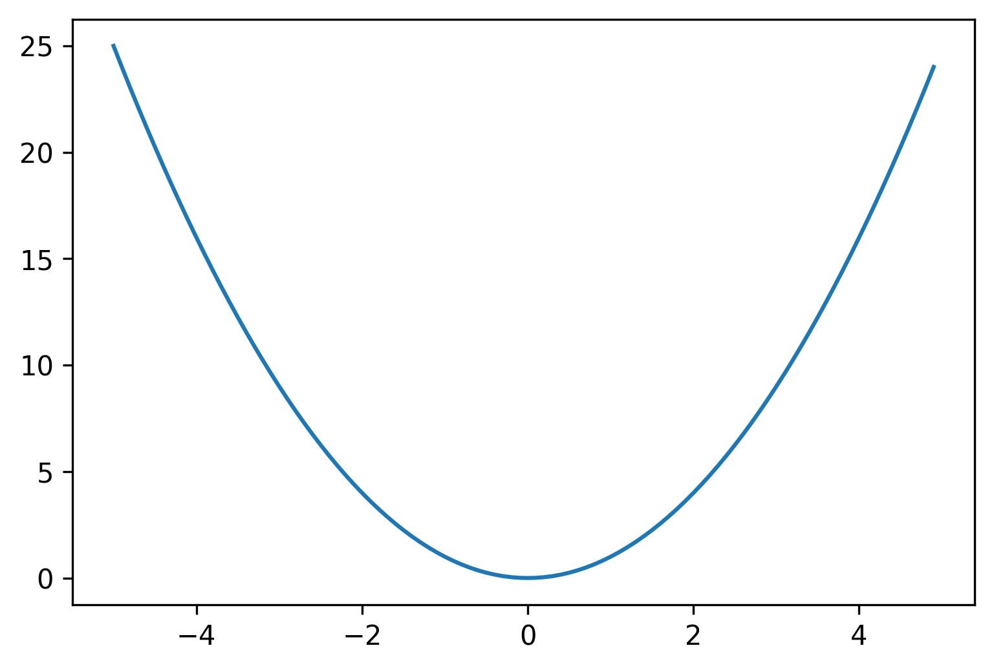
Learning rate influence
The learning rate is an important hyper-parameter of gradient descent.
Good convergence
Too large - poor convergence
Too large - no convergence
$$J(w)$$
$$J(w)$$
$$J(w)$$
$$w$$
$$w$$
$$w$$

Slide 37
Gradient descent Line Fitting with Mean Square Error
https://scipython.com/blog/visualizing-the-gradient-descent-method/

Slide 38
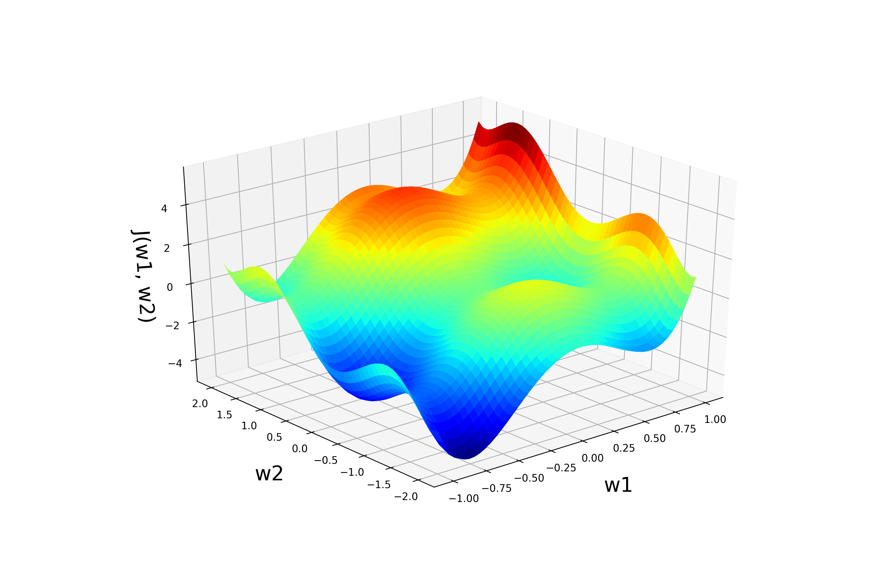
Gradient descent
Gradient

Slide 39
Gradient descent
Update

Slide 40
Gradient descent
Continue until convergence (gradient close to zero).
Update

Slide 41
Gradient descent
Initialize weights $w$
Loop until convergence
Run forward pass
Compute gradients
Update weights
Update

Slide 42
Stochastic Gradient descent
Reduces the computational cost
No need to run inference on all data points
Initialize weights $w$
Loop until convergence
Select a random batch
Run forward pass
Compute gradients
Update weights
Update

Slide 43
Gradient descent
There is no guarantee a global minimum will be reached.
Update

Slide 44
Backprop – Backward Pass Update weights $W$ to minimize the cost function $J$
Learning rate
$$1$$
$$w_{j}←w_{j} −ε\frac{∂J(x,y, W)}{∂w_{j}}$$
$$w_{0}$$
$${ x}_{1}$$
$$w_{1}$$
$$w_{2}$$
$${ x}_{2}$$
$$∑$$
$$z$$
$$g$$
$$\hat{y}$$
$$J$$
$$\frac{∂J\left(x, y, W\right)}{∂w_{j}}=\frac{∂J}{∂\hat{y}}\frac{∂\hat{y}}{∂z}\frac{∂z}{∂w_{j}}$$
$$z=x^{T}W=\sum_{j=1}^{n_{x}}{w_{j}x_{j}}$$
$$⋮$$
$$w_{n}$$
$${ x}_{n}$$

Slide 45
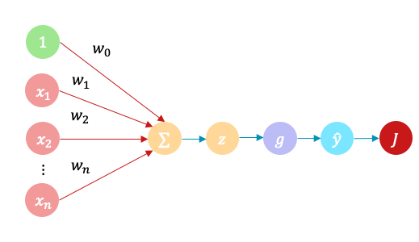
Backprop – Linear regression example
$$\frac{∂J}{∂\hat{y}}=\frac{∂ℒ}{∂\hat{y}}=\hat{y}−y$$
Considering a single instance $x$
Linear regression
MSE: $ℒ\left(\hat{y},y\right)={1/2\left(f^{∗}\left(x;W\right)−y\right)}^{2}$
Linear: $g(z)=z$

Slide 46
Backprop – Linear regression example
$$\frac{∂J}{∂\hat{y}}=\hat{y}−y \\ \frac{∂J}{∂\hat{y}}\frac{∂\hat{y}}{∂z}=\left(\hat{y}−y\right)∗1$$
Linear regression
MSE: $ℒ\left(\hat{y},y\right)={1/2\left(f^{∗}\left(x;W\right)−y\right)}^{2}$
Linear: $g(z)=z$

Slide 47
Backprop – Linear regression example
$$\frac{∂J}{∂\hat{y}}=\hat{y}−y \\ \frac{∂J}{∂\hat{y}}\frac{∂\hat{y}}{∂z}=\left(\hat{y}−y\right)∗1 \\ \frac{∂J}{∂\hat{y}}\frac{∂\hat{y}}{∂z}\frac{∂z}{∂w_{i}}={\left(\hat{y}−y\right)∗1∗x}_{i}$$
Linear regression
MSE: $ℒ\left(\hat{y},y\right)={1/2\left(f^{∗}\left(x;W\right)−y\right)}^{2}$
Linear: $g(z)=z$
$$w_{i}←w_{i}−ε\left(\hat{y}−y\right)x_{i}$$

Slide 48
Backprop – logistic function example
$$\frac{∂J}{∂\hat{y}}=\hat{y}−y \\ \frac{∂J}{∂\hat{y}}\frac{∂\hat{y}}{∂z}=\left(\hat{y}−y\right)\left(1−σ\left(z\right)\right)\left(σ\left(z\right)\right) \\ \frac{∂J}{∂\hat{y}}\frac{∂\hat{y}}{∂z}\frac{∂z}{∂w_{i}}={\left(\hat{y}−y\right)\left(1−σ\left(z\right)\right)\left(σ\left(z\right)\right)x}_{i}$$
Linear regression
MSE: $ℒ(\hat{y}, y)={1/2\left(f^{∗}\left(x;W\right)−y\right)}^{2}$
Logistic: $g\left(z\right)=\frac{1}{1+e^{−z}}$
$$w_{i}←w_{i}−ε\left(\hat{y}−y\right)\left(1−σ\left(z\right)\right)\left(σ\left(z\right)\right)x_{i}$$

Slide 49
Backprop – Expectation over $m$ instances
$$\frac{∂J}{∂\hat{y}}=\frac{∂}{∂\hat{y}}𝔼_{x,y}ℒ\left(\hat{y},y\right)=𝔼_{x,y}\frac{∂}{∂\hat{y}}ℒ\left(\hat{y},y\right)=\frac{1}{m}\left(\hat{y}−y\right) \\ \frac{∂J}{∂\hat{y}}\frac{∂\hat{y}}{∂z}=\frac{1}{m}\left(\hat{y}−y\right)\left(1−σ\left(z\right)\right)\left(σ\left(z\right)\right) \\ \frac{∂J}{∂\hat{y}}\frac{∂\hat{y}}{∂z}\frac{∂z}{∂w_{i}}={\frac{1}{m}\left(\hat{y}−y\right)\left(1−σ\left(z\right)\right)\left(σ\left(z\right)\right)x}_{i}$$
Linear regression
MSE: $ℒ(\hat{y}, y)={1/2\left(f^{∗}\left(x;W\right)−y\right)}^{2}$
Logistic: $g\left(z\right)=\frac{1}{1+e^{−z}}$

Slide 50
Choosing the Learning Rate
Grid search Try different learning rates and pick one that yields the best model (lowest cost after training). This is also done for other hyper-parameters of the architecture.
Adaptive learning rates Update the learning rate during training.

Slide 51
Adaptive Learning Rate
Annealing learning rate Gradually reduce the learning rate during the learning process.
1. Step decay Every few steps do
$$ε←kε, k∈(\text{0, 1)}$$
2. Exponential decay
$$ε←ε_{0}e^{−kt}, k>0, t steps$$
3. $\frac{1}{t}$ decay
$$ε←{ε_{0}}/{\left(1+kt\right), k>0, t steps }$$

Slide 52
Adaptive Learning Rate
Compute a velocity term Previous velocity $v$ + gradient at current $W$
Momentum
$$v_{ }←μv−ε∇_{W}J\left(W\right) \\ W←W+v$$
Update the weights by current velocity
Gradient is too low here and we stop
Velocity keeps us going to a better local optimum
Adding momentum
$$J(w)$$
$$J(w)$$
$$w$$
$$w$$

Slide 53
Per-parameter Adaptive Learning Rate
Each parameter learning rate has a dedicated learning rate.
Small gradients large learning rates
Large gradients small learning rates
Several methods have been proposed
RMSProp
Adagrad
Adadelta
Adam (usually suggested as default)

Slide 54
REGULARISATION

Slide 55
Overfitting Low bias - High variance
https://pythonmachinelearning.pro/a-guide-to-improving-deep-learnings-performance/

Slide 56
Regularisation
Occam razor
Techniques to favour simple models over complex ones.
Generalisation
Reduce variance to improve performance on unseen data.
Most common techniques
L2 regularisation
Dropout

Slide 57
L2 Regularisation
Penalization proportional to the square of the weights
Weights close to the origin - Weight decay $R_{L2}\left(W\right)=\frac{α}{2}{\left\|W\right\|}_{2}^{2}=\frac{α}{2}W^{T}W$
New cost function and update
$$\tilde{J}\left(X, y, W\right)=\frac{α}{2}W^{T}W+J\left(X, y, W\right)$$
$$∇\tilde{J}\left(X, y, W\right)=αW+∇J\left(X, y, W\right)$$
$$W←W −ε\left(αW+∇J\left(X, y, W\right)\right)$$
$$W←\left(1 −αε\right)W−ε\left(∇J\left(X, y, W\right)\right)$$

Slide 58
Dropout
During training, set each activation to zero with probability $p$
$$1$$
$$h_{1}$$
$$h_{1}$$
$$h_{1}$$
$$\hat{y_{1}}$$
$${ x}_{1}$$
$$h_{2}$$
$$h_{2}$$
$$h_{2}$$
$$\hat{y_{2}}$$
$${ x}_{2}$$
$$…$$
$$⋮$$
$$⋮$$
$$⋮$$
$$⋮$$
$$⋮$$
$$h_{n_{h_{1}}}$$
$$h_{n_{h_{2}}}$$
$$h_{n_{h_{3}}}$$
$$\hat{y_{n_{y}}}$$
$${ x}_{n}$$

Slide 59
Dropout
During training, set each activation to zero with probability $p$
$$1$$
$$h_{1}$$
$$h_{1}$$
$$h_{1}$$
$$\hat{y_{1}}$$
$${ x}_{1}$$
$$h_{2}$$
$$h_{2}$$
$$h_{2}$$
$$\hat{y_{2}}$$
$${ x}_{2}$$
$$…$$
$$⋮$$
$$⋮$$
$$⋮$$
$$⋮$$
$$⋮$$
$$h_{n_{h_{1}}}$$
$$h_{n_{h_{2}}}$$
$$h_{n_{h_{3}}}$$
$$\hat{y_{n_{y}}}$$
$${ x}_{n}$$

Slide 60
Dropout
During training, set each activation to zero with probability $p$
During test, multiply each activation by $p$
maintain the expected value of each activation
Dropout mimics bagging
an exponentially number of networks are trained
Intuition: The network cannot rely on any one set of neurons
Practical tip: A dropout of $p=0.5$ is typical

Slide 61
Another way to avoid overfitting
If we train this model all the way, how would it fare in the test data?
Validation
Training
Empirical loss
Iterations

Slide 62
Another way to avoid overfitting
Early stopping: Stop training when the loss in the validation and training sets start to diverge
Validation
Training
Empirical loss
Stop training
Iterations

